Slide 1
Software Architecture DIT344
Recap UML & Requirements & Quality Attributes
Michel Chaudron
Chalmers | University of Gothenburg

Slide 2
Schedule
Week |  | Date | Time | Lecture | Reading | Assignmnt
36 | L1 | 5 sept | 13:00 – 15:00 | Introduction & Organization
37 | L2 | 12 sept | 13:00 – 14:30 | Architecting Process & Views | Ch 1 & 2
37 | S1 | 13 sept | 10:15 - 1200 | << Supervision/Assignment>> |  | Release Ass 1.0
38 | L3 | TUE 18 sept | 15:15 – 17:00 | Views, Viewpoints & Quality Attributes | Ch 3 & 4
38 | S2 | THU 20 sept | 13:00 – 15:00 | << Supervision/Assignment>> | IEEE standard | Continue Ass 1
38 | L4 | FRI 21 sept | 13:15 – 15:00 | Architectural Styles 1 | Ch 13
39 | L5 | MON 24 sept | 14:00 | deadline |  | hand in for Ass 1
 |  | WED 26 sept | 14.00-15.30 | Seminar Claudia Eckart (Room Tesla) + coffee | Ch 15 & 16 | Location: Lindholmen conference centre, Lindholmspiren 5
39 | S3 | THU 27 sept | 10:15 – 12:00 | << Supervision/Assignment>> |  | release Ass 2.0
39 | L6 | 28 sept | 13:15 – 15:00 | Design Principles | Check GUL
40 | L7 | 3 Oct | 13:15 – 15:00 | Technical Debt | Check GUL
40 | S4 | 4 Oct | 10:15 – 12:00 | << Supervision/Assignment>> |  | supervision
40 | L8 | 5 Oct | 13:15 – 15:00 | Roles and Responsibilities | tbd
 |  | 8 Oct |  |  |  | hand in Ass 2.0
41 | L9 | 10 Oct | 13:15 – 15:00 | Architecture Evaluation | Ch 21
41 | S5 | 11 Oct | 10:15 – 12:00 | << Supervision/Assignment>> |  | Mandatory workshop!
42 | L10 | 17 Oct | 13:15 – 15:00 | Magnus Standar from Ericsson.
 |  | 18 Oct | 10:15 – 12:00 | << Supervision/Assignment>> |  | Feedback on Ass 2
42 | L11 | 19 Oct | 13:15 – 15:00 | To be determined | MODELS
43 | L12 | 24 Oct | 13:15 – 15:00 | Reverse Engineering & Correspondence | Ch 20
43 | S6 | 25 Oct | 10:15 – 12:00 | << Supervision/Assignment>>
43 | L13 | 26 Oct | 13:15 – 15:00 | To be determined |  | Architectural Styles 2
 |  |  |  |  |  | …

Slide 3
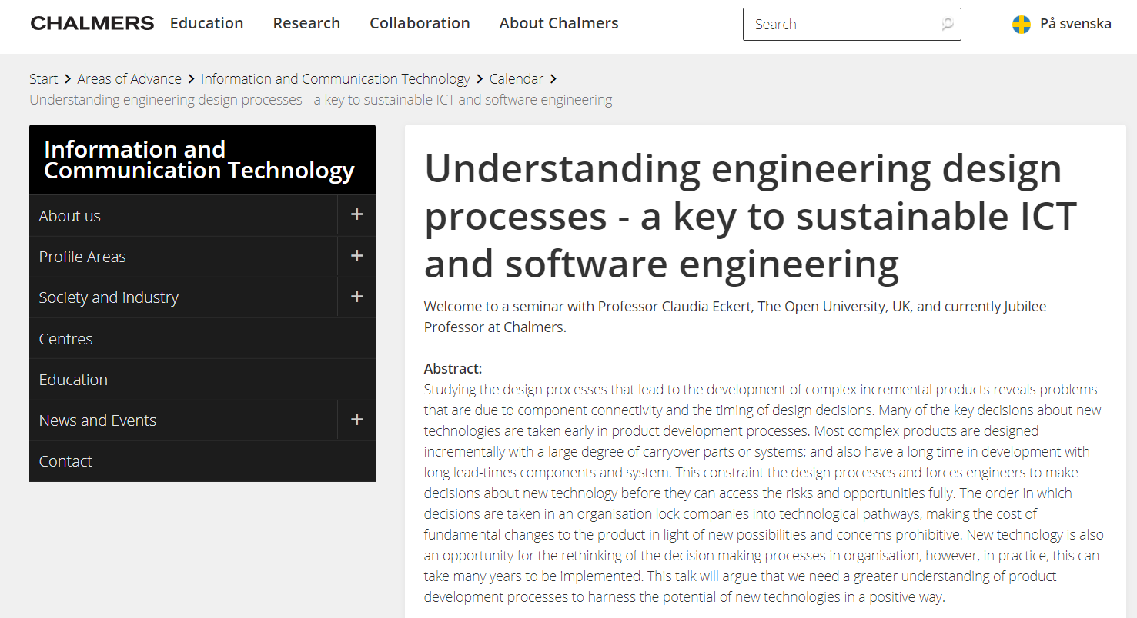

Seminar on Wed 26th Sept 14:00 – 15:30 + coffee Room Tesla, Lindholmen conference centre

Slide 4
Things we have seen so far
What, why, who, where, when, how
Many definitions and resources, hopefully converging
Levels of architecture
Every software system has a software architecture
Not all architectures are good architectures
Architecture includes behavior
Central questions: design, document and assess software architectures

Slide 5
Objectives
In this lecture you will learn:
View and Viewpoints
And how to use UML to describe them
What are requirements
What is software quality
What are quality-attributes (QA)?
Relation between (QA) requirements & software architecture
Main idea of ‘Architectural Style’

Slide 6
Forces

Slide 7

Architectural Drivers
Architectural drivers are the design forces that influence the early design decisions the architects make
Architectural drivers are not all the requirements for a system, but they are those requirements, that are most influential to the architect making early design decisions.
→ architecturally significant requirements
Architects pay more attention to qualities that relate to architecture design choices

Slide 8
Outline
Recap : What is Software Architecture?
Stakeholders
How to do Software Architecting?
4+1 Views
Concluding Remarks

Slide 9
What is Software Architecture?

Slide 10
Outline
What is Software Architecture?
Stakeholders
How Software Architecting?
4+1 Views
Concluding Remarks & References

Slide 11
International Standard specifies the manner in which architecture descriptions of systems are organized and expressed.

Slide 13
Views and Viewpoints

Slide 14
System exhibit an architecture
Architecture descriptions express an architecture
An architecture description consists of 1 or more views
Each architecture view addresses a concern
Each view is governed by a viewpoint
Viewpoints use 1 or more model-kinds
Model kinds are like a ‘language’ for describing a view (for a particular concern)

Slide 15
Examples
System: Browser
Concern: Privacy
Viewpoint: Security (Privacy)
Model-kind: UML-SEC
UML-SEC is an extension of UML with security-annotations
Model:

Slide 16
Overview (According to IEEE 42010)
has
1..*
system
stakeholder
has
has
1..*
concern
architecture
addresses
1..*
viewpoint
model-kind
described by
conforms to
is expressed by
1
architectural
description
1..*
view
model
is organised by
consists of
Notes:
Models may be part of multiple views

Slide 17
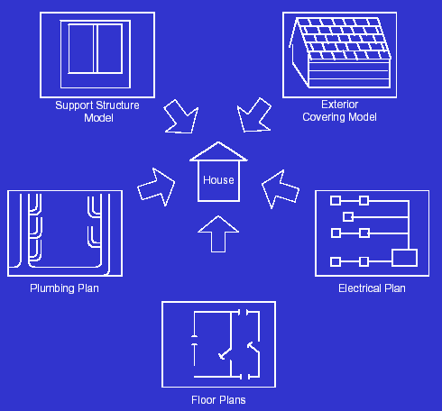
Viewpoints & views
view
view
point

Slide 18
Architectural view
An architectural view is a simplified description (an abstraction) of a system from a particular perspective/view point, covering particular concerns, and omitting entities that are not relevant to this perspective

Slide 19
View: Definition (from IEEE 1471)
3.4 Architectural Description (AD): A collection of products to document an architecture.
3.9 View: A representation of a whole system from the perspective of a related set of concerns.
A view may consist of one or more architectural models
Each such architectural model is developed using the methods established by its associated architectural viewpoint.
An architectural model may participate in more than one view.

Slide 20

Overview - example
Traffic light
has
1..*
Driver
system
stakeholder
has
has
Timeliness
1..*
Safety
concern
Traffic Light
Architecture
architecture
is addressed by
Timeliness- viewpoint
Timing- diagram-language
1..*
viewpoint
described by
1
conforms to
TLA
Description
Timing- view
Timing- diagrams
architectural
description
1..*
view
is organised by
consists of
Notes:
Models may be part of multiple views

Slide 21
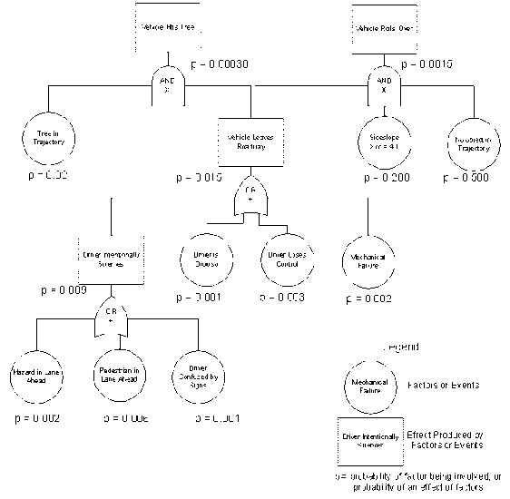
Example (According to IEEE 1471)
has
1..*
Railway system
Passenger
has
has
1..*
safety
architecture
is addressed by
1..*
Model-kind:
Fault trees
safety-viewpoint
described by
1
conforms to
architectural
description
behaviour
structure
is organised
by
deployment
…
consists of
Notes:
Models may be part of multiple views

Slide 22
4+1 Views Model
Borrowed from Grady Booch on architecting
www.rational.com
Approach inspired by 4+1 views model by Kruchten

Slide 23
The 4 + 1 View Model (Kruchten95)
Structure: Component diagrams
Config. Mngnt policies
Structure
view
Development
view
Use case
view
Process
view
Deployment
view
Use case
models
Deployment diagrams
structure of infrastructure
rules for mapping of design
and process view onto infra
Statechart diagrams (intra)
Interaction diagrams (inter)

Slide 24
4+1 Views Representation of System Architecture
What can/does the system do ?
How is the system structured?
How to build / configure ?
Structure View
Development View
System Architect
End-user
Programmers
Configuration management
Functionality (Decomposition)
Use Case View
How does the system behave?
Where to install ?
What hw\nw is used?
Process View
Deployment View
System Architect
System engineering
System topology
Delivery, installation, maintenance
Performance, Scalability, Throughput
Concurrency, Communication,
Synchronization
How does the system perform ?

Slide 25
Example 4+1 Views model
Structure view: components, packages, interfaces
Development view
file ownership
Config. Mngnt view
versioning policies
…
A
B
Stakeholders &
Use cases view
C
D
Behaviour view:
MSC, state-diagrams
Deployment view:
physical model + mapping
A
B
C
D
A
C
D
B
TCP/IP over Ethernet
BC/WC e2e-response times, freq.
bandwidth, availability

Slide 26
Discussion
Why should we use different diagrams?
Why should we use different views?

Slide 27

Some viewpoints important for some systems, but not for others
Legal?
Sustainability?
For some views no standard model-kind (‘language’) exists
Need to invent one yourself

Slide 28
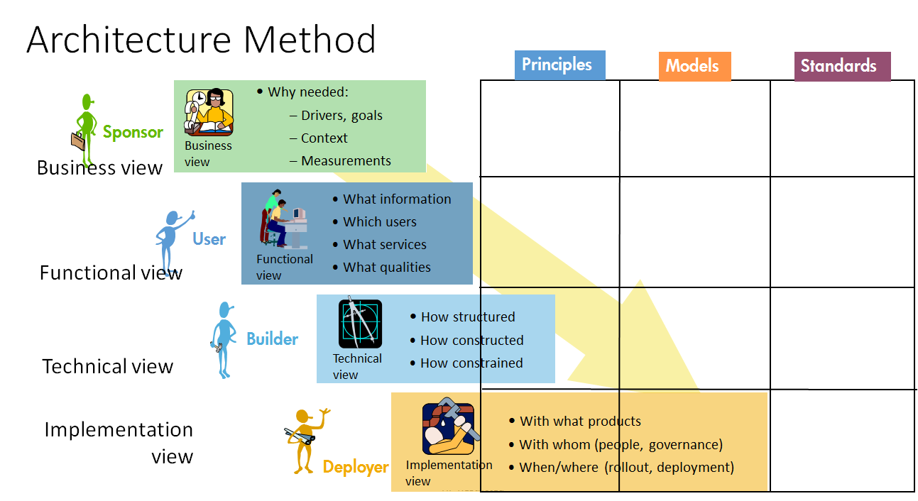
Domain
Solution Design view
Solution Construction view

Slide 29
What is a subsystem/component?
Sub-system models is a logical grouping of functionality into a coherent subsystems
Operate on the same data
Perform functions that belong to the same responsibility

Slide 30
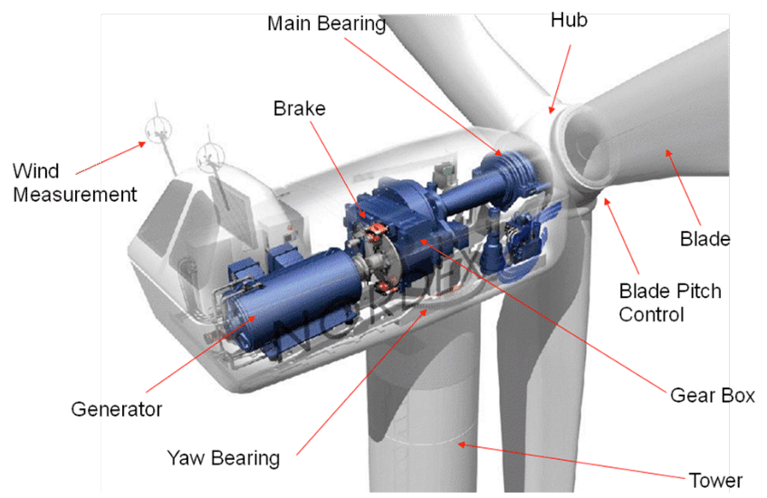
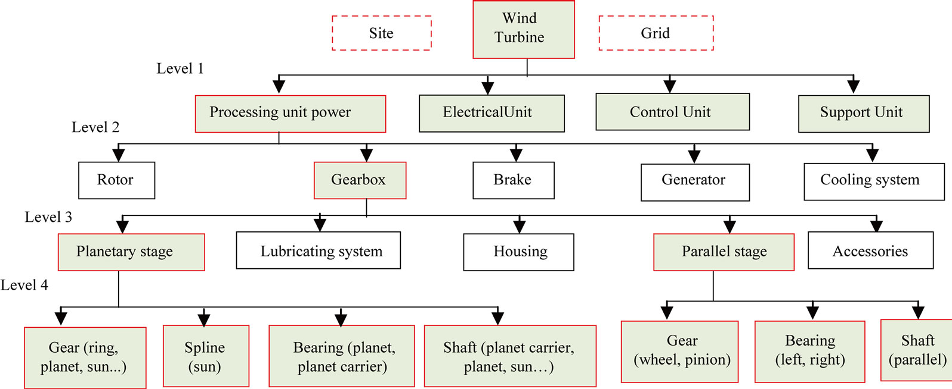
Subsystem Functions

Slide 31
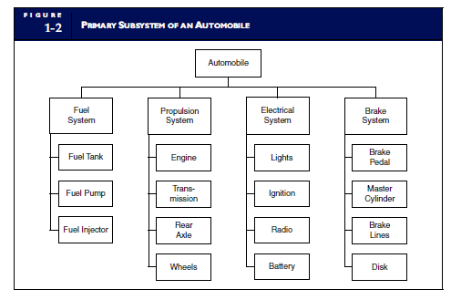

Slide 32
Subsystems vs Layering
Functional
Dimension
Fuel System
Propulsion System
Electrical System
Braking System
Layer 1
Layer 2
Layer 3
Abstraction
Dimension
Again: natural language is used in imprecise manner

Slide 33
Multiple diagram types per View
4+1 View Model
(Philippe Kruchten)
Logical View
Process View
Deployment View
Development View
Scenario View
Unified Modeling Language
UML is de-facto industry standard
Component, Class diagram
Use Case diagram
Object diagram
State-chart diagram
Sequence diagram
Collaboration diagram
Activity diagram
Deployment diagram
Multiple diagram types may be used in one view

Slide 34
Show example

Slide 35
4 + 1: Logical Viewpoint
The logical viewpoint supports the functional requirements, i.e., the services the system should provide to its end users.
Typically, it shows the key abstractions (e.g., classes and interactions amongst them).
Notes:
The logical view primarily supports the functional requirements; the services the system should provide to its end users.It depicts the major design elements and their interaction.
Designers decompose the system into a set of key abstractions, taken mainly from the problem domain. These abstractions are objects or object classes that exploit the principles of abstraction, encapsulation, and inheritance. In addition to aiding functional analysis, decomposition identifies mechanisms and design elements that are common across the system.
Components are related by “shares data with”
In termen van het boek is dit een module view

Slide 36
4 + 1: Process Viewpoint
Addresses concurrent aspects at runtime (tasks, threads, processes and their interactions)
It takes into account some nonfunctional requirements, such as performance, system availability, concurrency and distribution, system integrity, and fault-tolerance.
Notes:
The process view takes into account some nonfunctional requirements, such as performance and system availability. It addresses concurrency and distribution, system integrity, and fault-tolerance. The process view also specifies which thread of control executes each operation of each class identified in the logical view.
So the process view describes the mapping of functions to runtime elements. It concenrs the dynamics of the system. A process is a group of tasks which form a logical unit. A process can be started, stopped, resumed, etc., and there is communication between processes.
Components are related by “synchronizes with”
In termen van het boek: een C&C view

Slide 37
4 + 1: Deployment Viewpoint
The deployment viewpoint defines how the various elements identified in the logical, process, and implementation viewpoints-networks, processes, tasks, and objects-must be mapped onto the various nodes.
It takes into account the system's nonfunctional requirements such as system availability, reliability (fault-tolerance), performance (throughput), and scalability.
Notes:
The physical view takes into account the system's nonfunctional requirements such as system availability, reliability (fault-tolerance), performance (throughput), and scalability. The software executes on a network of computers (the processing nodes). The various elements identified in the logical, process, and development views-networks, processes, tasks, and objects-must be mapped onto the various nodes. Several different physical configurations will be used-some for development and testing, others for system deployment at various sites or for different customers. The mapping of the software to the nodes must therefore be highly flexible and have a minimal impact on the source code itself.
Components are related by “communicates with”
In termen van het boek: een allocation view

Slide 38
4 + 1: Implementation Viewpoint
The imlementation viewpoint focuses on the organization of the actual software modules in the software-development environment.
The software is packaged in small chunks-program libraries or subsystems-that can be developed by one or more developers.
Notes:
The development view focuses on the organization of the actual software modules in the software-development environment. The software is packaged in small chunks-program libraries or subsystems-that can be developed by one or more developers. The subsystems are organized in a hierarchy of layers, each layer providing a narrow and well-defined interface to the layers above it.
Components are related by “is submodule of”.
In termen van het boek: een allocation view

Slide 39
4 + 1: Scenario Viewpoint
The scenario viewpoint consists of a small subset of important scenarios (e.g., use cases) to show that the elements of the four viewpoints work together seamlessly.
This viewpoint is redundant with the other ones (hence the "+1"), but it plays two critical roles:
it acts as a driver to help designers discover architectural elements during the architecture design;
it validates and illustrates the architecture design, both on paper and as the starting point for the tests of an architectural prototype.
Notes:
The scenario view consists of a small subset of important scenarios-instances of use cases-to show that the elements of the four views work together seamlessly. For each scenario, we describe the corresponding scripts (sequences of interactions between objects and between processes). This view is redundant with the other ones (hence the "+1"), but it plays two critical roles:
it acts as a driver to help designers discover architectural elements during the architecture design;
it validates and illustrates the architecture design, both on paper and as the starting point for the tests of an architectural prototype.
The scenario view is important for stakeholder communication.

Slide 40
Requirements Engineering
Based on Selections from
Chapter 4 from Object-Oriented Software Engineering
by Lethbridge & Laganiere
Requirements Engineering: A Good Practice Guide
by Ian Sommerville & Pete Sawyer
What, Why, Who, When, Where, How?

Slide 41
Requirements Engineering
The process of establishing the services that the customer requires from a system and the constraints under which it operates and is developed.
The requirements themselves are the descriptions of the system services and constraints that are generated during the requirements engineering process.
©Ian Sommerville 2004 Software Engineering, 7th edition. Chapter 6

Slide 42
What is a Requirement ?
A statement about the proposed system that all stakeholders agree must be made true in order for the customer’s problem to be adequately solved.
Short and concise piece of information
Says something about the system
All the stakeholders have agreed that it is valid
It helps solve the customer’s problem
Notes:
L & L Section 4.4

Slide 43

Requirements should set out what the system should do rather than how this is done.
Through Requirements you are meant to find out and understand what users’ intentions and need are.
This may be different from what they say it is!

Slide 44
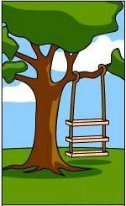






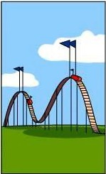
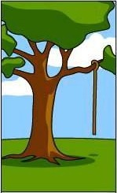
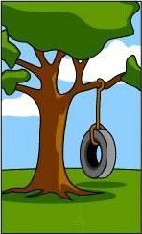
Understanding the problem
What the customer
explained
What the project leader understood
What the analyst designed
What the consultant defined
What the programmer made
How it was maintained
What was documented
What was charged
What was installed
What the client needed

Slide 45
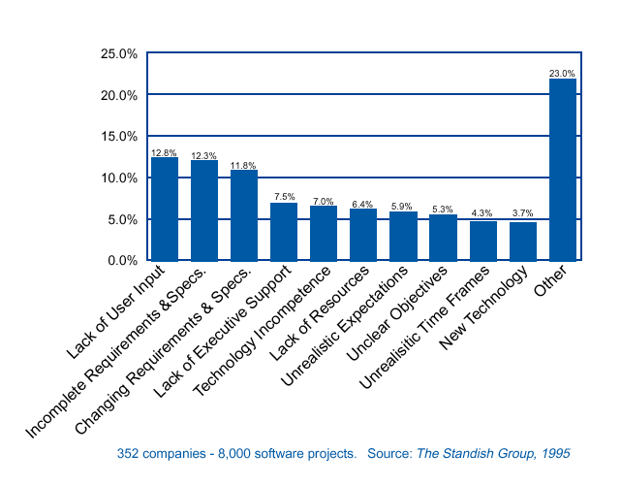
Why Software Projects Fail
Related to
Requirements
Engineering
Example of empirical research
Notes:
Example of result of empirical research

Slide 46

Why Requirements Engineering?
Scope the problem
Understand the problem
for the client as well as the architect
Basis for design
Contract between client/user and builders
agreement on what has to be built

Slide 47
Types of Requirements
Functional requirements
Describe what the system should do
Extra-functional requirements
*ilities: Availability, Security, Reliability, Timeliness,
Capacity
Constraints that must be adhered to during execution
Notes:
L&L Section 4.5

Slide 48
Functional requirements
What inputs the system should accept
What outputs the system should produce
What data the system should store that other systems might use
What computations the system should perform

Slide 49
Examples
The system shall allow users to search for an item by title, author, or ISBN.
Defines system functionality.
If an item is not returned within the period of load, then the person who loans the item will be fined Euro 1 per week.
Defines (causal) relations between system functions.

Slide 50
Examples of XFR: Reliability
Typically expressed in terms of
Mean Time Between Failures (MTBF)
Number of hours that pass before a component fails
E.g. 2 failures per million hours:
MTBF = 10⁶ / 2 = 0,5 * 10⁶ hr
Mean Time To Failure (MTTF)
Mean time expectec until the first failure of a system
Is a statistical value over a long period of time
Mean Time To Repair (MTTR)
for repairable systems
For non-repairable systems
Availability

Slide 51
Examples XFR: Maintainability
Maintainability
The average person time required to fix a category 3 defect (including testing and documentation upgrade) shall not exceed two person days.

Slide 52
Constraints
Constraints concerning the environment and technology of the system.
Platform
Technology to be used
Constraints concerning the project plan and development methods
Development process (methodology) to be used
Cost and delivery date
Often put in contract or project plan instead

Slide 53
Constraints
Constraint set restrictions on how the user requirements are to be implemented.
Interface Requirements. How external interfaces with other systems must be done.
Communication Interfaces. The networks and protocols to be used.
Hardware Interfaces. The computer hardware the software is to execute on.
Software Interfaces. How the software should be compatible with other software: applications, compilers, operating systems, programming languages, database management systems.
User Interfaces. Style, format, messages

Slide 54

Requirements on Requirements (3)
S Specific
To-the-point, precise
M Measurable
Quantifiable and verifiable
A Acceptable (to the stakeholders)
Accessible, understandable (for the user)
Achievable (technically/planning/economically)
R Realistic
Deducible to the real business drivers
T Testable

Slide 55

Quality Requirements for SOLA
Identifier | Feature Description | Priority
QL-1 | The system will capable of supporting multiple languages and compatible with Unicode 3.0+ and UTF-8 encoding. | 10
QL-2 | The system will support optimistic concurrency control for real time transaction processing. | 10
QL-3 | The system will support a rules engine that will allow definition and maintenance of business rules. | 6
General Quality Requirements

Slide 56
Quality Requirements for SOLA
Identifier | Feature Description | Priority
QL-35 | The system will be capable of supporting peak user volumes up to 100 users | 10
QL-36 | The system will process and respond to login requests in less than 5 seconds 90% of the time when subjected to peak user volumes. | 10
QL-37 | The system will process and respond to general transactions in less than 5 seconds 90% of the time when subjected to peak user volumes. | 10
QL-38 | The system will process and response to process intensive transactions in less than 8 seconds 90% of the time when subjected to peak user volumes. | 10
QL-39 | The system will perform document generation in less than 30 seconds 90% of the time when subjected to peak user volumes. | 10
Performance Requirements

Slide 57
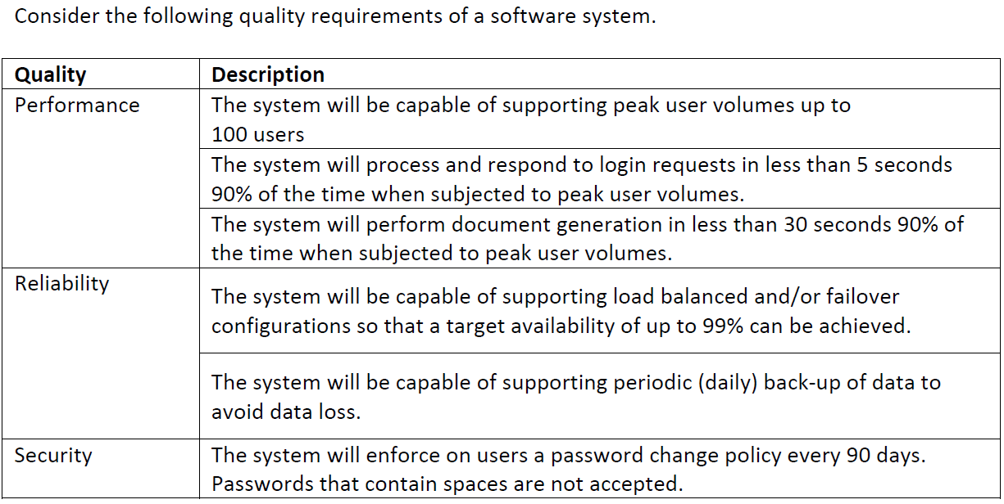
Question
Give quality attribute scenarios for above quality requirements.

Slide 58
Typical exam question
Consider a system that does
Ticket booking
Video streaming
…
Write a scenario for the following quality attribute
Reliability
Performance
Security
….

Slide 59
Requirements on Requirements (1)
Each individual requirement should be
Important/necessary for the solution of the current problem
Unique (no duplicates/overlap)
Unambiguous
Logically consistent
Not over-constrain the design of the system
Atomic: not consist of multiple separate requirements
Notes:
L & L Section 4.8

Slide 60
Requirements on Requirements (2)
Nice to have properties of requirements :
Complete (?)
Expressed using a clear and consistent notation
at the same level of detail
Notes:
L & L Section 4.8

Slide 61
Public Transport e-ticketing system
The system should be aware of interchanges made by the traveller
The system should be able to register a valid period card on board of the transportation
The ticket system should send a response within 5 sec when an SMS is received from a customer
The system gives a written message that the user needs to recharge his card

Slide 62
A ticket should be valid for 90 minutes after being paid
The system shall be compatible with android mobile phones
System response time shall not exceed 2 sec
The card shall have its information encrypted with AES
Every ticket is identified uniquely in all the lifetime of the system

Slide 63
Tell if these are good/what is wrong?
“All communication between client and server is secure”
“It is easy to extend”
“The system should respond quickly”
“The user should not have to wait more than a few second …”
“Determine solution within 0.3 sec”
“The system should be always available”
“The system can handle multiple concurrent users”
“The system can handle 100 concurrent users”
“The system should be state-of-the-art …”

Slide 64
Let’s consider
“All communication between client and server is secure”
“It is easy to extend”
“The system should respond quickly”
“The user should not have to wait more than a few second …”
“Determine solution within 0.3 sec”
“The system should be always available”
“The system can handle multiple concurrent users”
“The system can handle 100 concurrent users”
“The system should be state-of-the-art …”
not measurable
not measurable
not measurable
not precise
vague:to what?
attainable
doing what?
time-dependent;
means something else tomorrow
subjective

Slide 65
Eliciting Requirements
Interviewing
Consult users
Consult experts
Observation
User interaction / work processes
Previous system / Existing system elsewhere
Brainstorming
Prototyping / Story-boarding

Slide 66
Requirements Prioritization

Slide 67
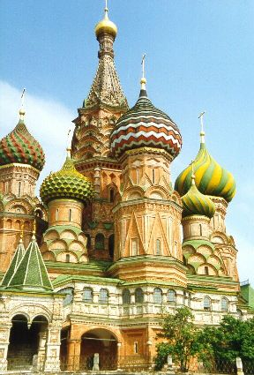
Prioritizing Requirements
MIL STD:
Must have, will have, may have
RUP: MoSCoW
Must have
Should have
Could have
Won’t have
Criteria: indicate importance
Alternative criteria: volitility, cost to realize, risk, ..

Slide 68
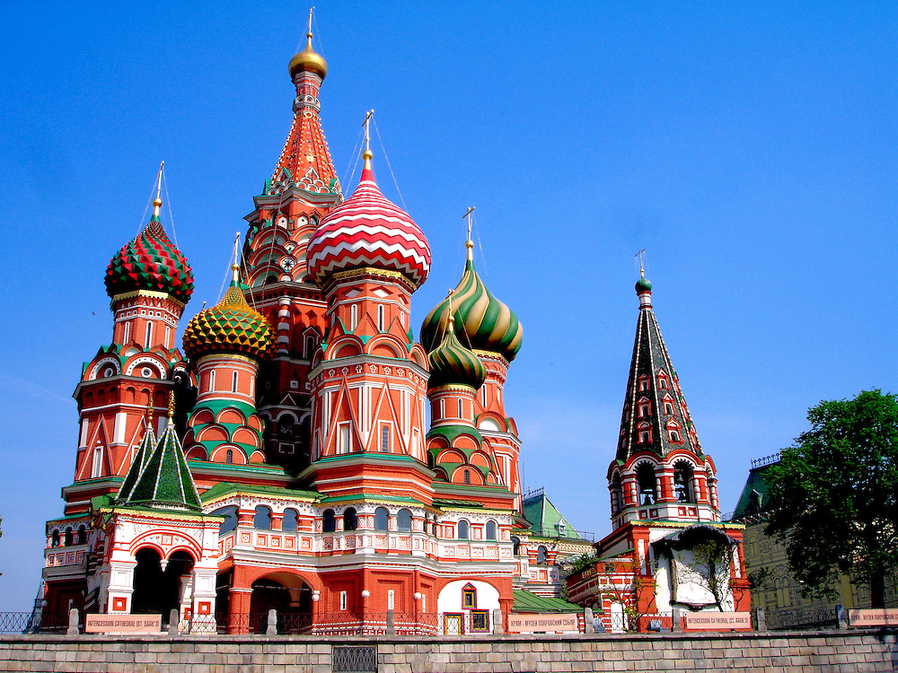
Prioritizing Requirements
MoSCoW Method:
M - MUST: Describes a requirement that must be satisfied in the final solution for the solution to be considered a success.
S - SHOULD: Represents a high-priority item that should be included in the solution if it is possible. This is often a critical requirement but one which can be satisfied in other ways if strictly necessary.
C - COULD: Describes a requirement which is considered desirable but not necessary. This will be included if time and resources permit.
W - WON'T: Represents a requirement that stakeholders have agreed will not be implemented in a given release, but may be considered for the future.

Slide 69

Question
Are business needs typically formulated around functional features or system qualities?

Slide 70
Quality Attributes*
Attribute | Description
Performance | How fast does it respond or execute?
Availability | Is it available when and where I need to use it?
Safety | How well does it protect against damage?
Usability | How easy it is for people to learn and use?
Interoperability | How easily does it interconnect with other systems?
Integrity | Does it protect against unauthorized access and data loss?
Installability | How easy is it to correctly install the product?
Robustness | How well does it respond to unexpected operating conditions?
Reliability | How long does it run before experiencing a failure?
Recoverability | How quickly can the user recover from a failure?
*EnfocusSolutions

Slide 71
Quality Attributes
Attribute | Description
Efficiency | How well does it utilize processor capacity, disk space, memory, bandwidth, and other resources?
Flexibility | How easily is it to modify functionality / UI?
Maintainability | How easy is it to correct defects or make changes?
Portability | How easily can it be made to work on other platforms?
Reusability | How easily can we use components in other systems?
Scalability | How easily can I add more users, servers, or other extensions?
Supportability | How easy will it be support after installation?
Testability | Can I verify that it is implemented correctly?

Slide 72
Quality Models
Quality Attributes | McCall, 1976/77 | Boehm, 1978 | FURPS, FURPS+ 1987, 1992 | ISO/IEC 9126, 1991 | Garvin, 1988
Aesthetics |  |  | Usability |  | *
Clarity |  | Understandability
Compatibility |  |  | Supportability
Conformance |  |  |  | Portability | *
Correctness | * | * |  | Maintainability
Device Efficiency | * | * | Performance | *
Documentation |  | * | Usability
Durability |  |  |  |  | *
Economy |  | *
Features |  |  |  |  | *
Flexibility | * | *
Functionality |  |  | * | *
Generality |  | *
Integrity | * | *
Interoperability | * |  |  | Functionality
Maintainability | * | * | Supportability | *
Modifiability |  | Maintainability |  | Maintainability
Modularity |  | *
Perceived Quality |  |  |  |  | *
Performance |  |  | * |  | *
Portability | * | * |  | *
Reliability | * | * | * | * | *
Resilience |  | Flexibility
Reusability | * | *
Security |  |  |  | Functionality
Serviceability |  |  | Supportability |  | *
Supportability |  |  | *
Testability | * | Maintainability | Supportability | Maintainability
Understandability |  | Maintainability |  | Usability
Usability | * | * | * | *
Validity |  | * |  | Maintainability

Slide 73
Addressing Quality Attributes
Quality attributes can be addressed through different (architectural) tactics:
Architectural styles: for example pipes-and-filters, MVC, blackboard, publish-subscribe,…
Design patterns: for example Abstract Factory, Adapter, Command, Observer,…
Quality requirements are often holistic they are a property of the system as a whole and cannot be decomposed into subsystems or components.
security
performance

Slide 74
Evaluating Quality Attributes
Quality attributes can be evaluated through:
Scenario-based evaluation: for example change scenarios for assessing maintainability
Simulation: for example Prototyping is a form of simulation where a part of the architecture is implemented and executed in the actual system context.
Mathematical modeling: for example, checking for potential deadlocks, performance, reliability.
Experience-based assessment: this is based on subjective factors like intuition and expertise of software engineers.

Slide 75
Specifying Quality Attribute Scenarios
A Quality Attribute Scenario is a format for defining a testable scenario for a system
Source of stimulus (e.g., human, system, 1 or more actor(s).)
Stimulus – the ‘trigger’ of the scenario
Environment - what are the conditions when the stimulus occurs?
Artifact – what elements of the system are stimulated.
Response – the activity undertaken after occurrence of the stimulus.
Response measure – when the response occurs it should be measurable so that the requirement can be tested.

Slide 76
Specifying Quality Attribute Scenarios
Reliability
Source of Stimulus | System Database Server
Stimulus | Database crashes
Environment | Runtime with average load
Artifact | Database
Response | Detect the failure, inform the sys-adm, use redundant database server
Response Measure | #seconds until recovery is at most 120

Slide 77
Summary / Conclusion
Requirements
Can write Requirements
SMART
QA Scenarios
Discuss Software Quality
What is Sw Quality?
Different perspectives on Sw Q?
Initial idea of Architectural Styles
We use the session this Friday

Slide 78
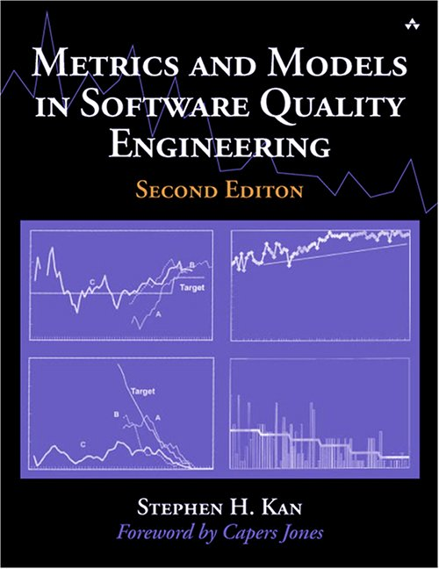
Literature on Software Quality
Metrics and Models in Software Quality Engineering (2nd edition) Stephen H. Kan Addison Wesley, 2002

Slide 79
What is Quality?

Slide 80
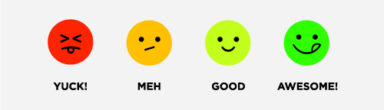
Perspectives on quality
Transcendent (“I really like this program”)

Slide 81
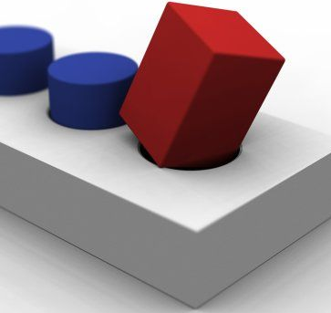
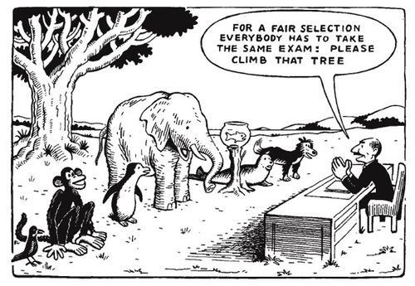
Fit for Purpose
A square peg does not fit a round hole.

Slide 82

Perspectives on quality
Product-based (based on attributes of the software)

Slide 83
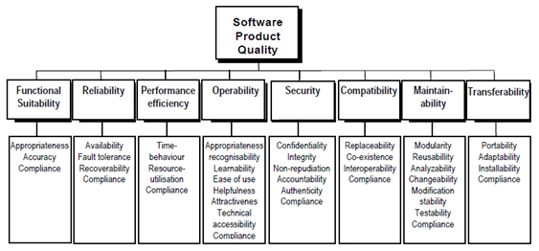
ISO 25010
ISO/IEC CD 25010 Software engineering — Software Product Quality Requirements and Evaluation (SQuaRE) — Quality model and guide, 2011.

Slide 84
Perspectives on quality
Manufacturing-based (conformance to specs)
The product is produced according to an approved recipe
Based on the premise:
If a proper process is followed for production:
Good quality products are bound to follow.
This idea derives from manufacturing industries: 1 process, many products. Software industry is different: 1 process for 1 product.
A process is necessary, but not sufficient.

Slide 85
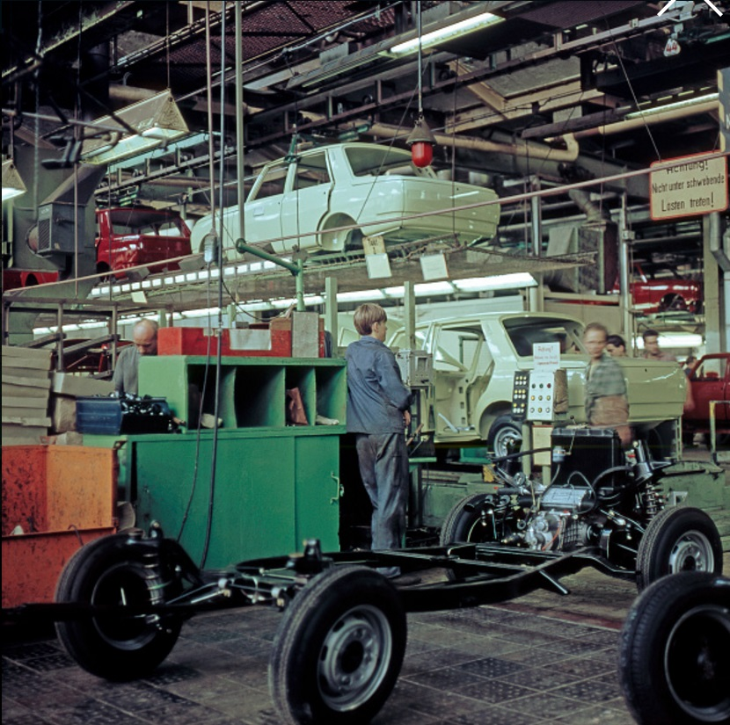

Slide 86
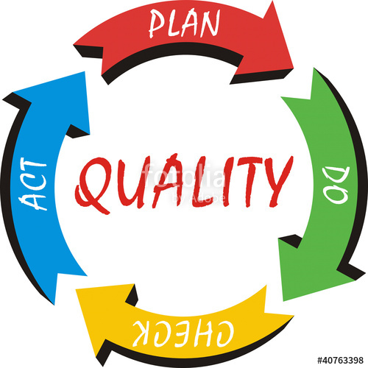
Process Improvement: Plan Do Check Act
Plan – set objectives
Do – produce
Check – assess/test analyse gap
Act – improve process

Slide 87
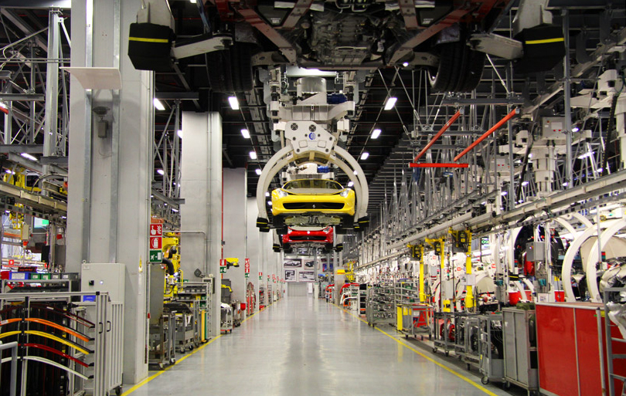
Production Process

Slide 88
Perspectives on quality
Transcendent (“I really like this program”)
User-based (“fitness for use”)
Product-based (based on attributes of the software)
Process/Manufacturing-based
Value-based (balancing time and cost vs profits)

Slide 89
Managing Software Quality
Main issues:
Quality cannot be added as an afterthought
In order to control, we must measure /know
Product quality vs process quality

Slide 90
Quality Attributes
A quality attribute is a measurable or testable property of a system that is used to indicate how well the system satisfies the needs of its stakeholders.*
A quality requirement is a specification of the acceptable values of a quality attribute that must be present in the system.
Quality attributes should be:
Objective
In sufficient detail
Of a value and context (e.g: 180 seconds)
*Bass Clements Kazman

Slide 91
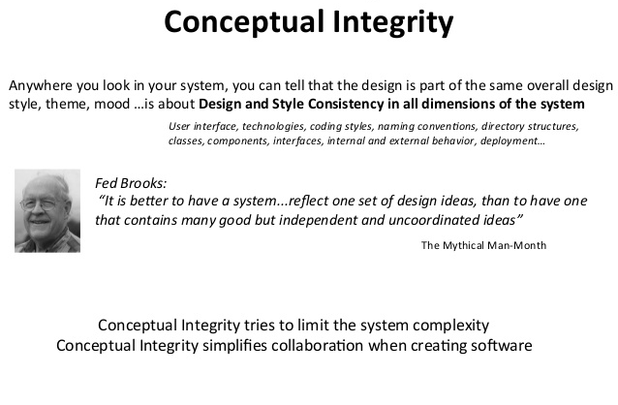

Slide 92
Architectural Styles
Architectural Styles help in
Achieving conceptual integrity
They define ‘ways’/vocabulary of construction:
Which types of components exist?
How do data and control flow through the system
Defaults for initiative and fault-handling.
A key task of the architect is to propose a ‘metaphor’ for the architecture – Alexander Ran (Nokia)

Slide 93
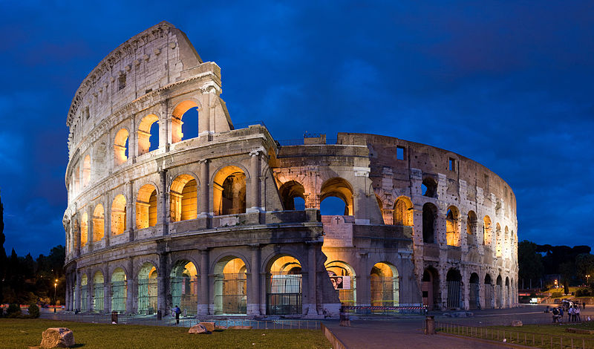
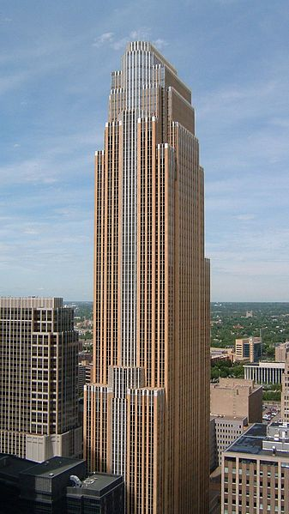
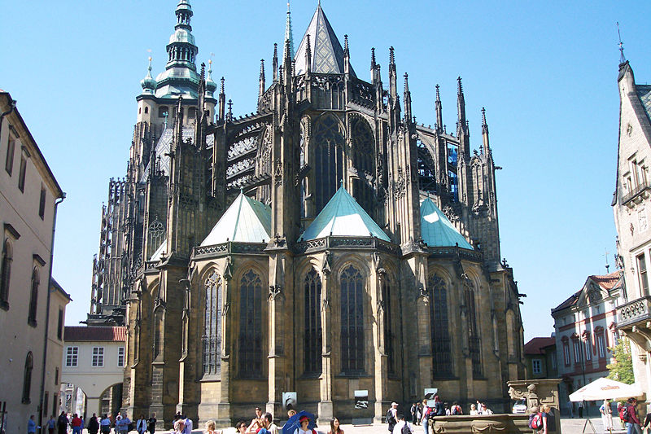

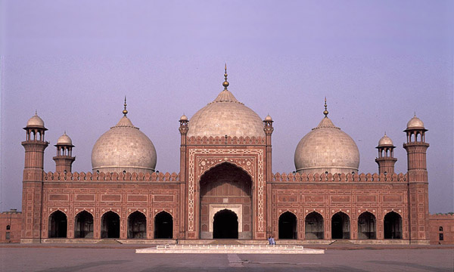
What is a Style?
Ancient Roman
Gothic
Postmodern
Islamic
Ancient Chinese

Slide 94

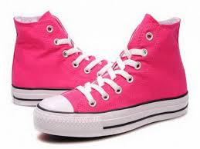
What is a Style?
Coordinated, aligned

Slide 95
What is an Architectural Style?
An architectural style is defined by:
a set of rules and constraints that prescribe
vocabulary/metaphor: which types of components, interfaces & connectors must/may be used in a system. Possibly introducing domain-specific types
structure: how components and connectors may be combined
behavior: how the system behaves
guidelines: these support the application of the style (how to achieve certain system properties)

Slide 96
What is an Architectural Style?
An architecture style defines a family of systems in terms of a pattern of structural organization.
An architectural style defines
a vocabulary of components and connector types
a set of constraints on how they can be combined
one or more semantic models that specify how a system’s overall properties can be determined from the properties of its parts

Slide 97
Quality Attributes & Architectural Styles
Different architectural styles address different sets of quality attributes and to varying degrees
Architecture decides range of quality possibilities
Not all quality attributes are addressed by the architectural design, e.g. some aspects of usability (e.g. layouts) and some aspects of performance (e.g. algorithms)
Impossible to maximize all quality attributes at once
Tradeoff: More of this → less of that
Performance versus security

Slide 98
What is an Architectural Style?
Architectural styles are design paradigms for a set of design dimensions
Some architectural styles emphasize different aspects such as: Subdivision of functionality, topology or interaction style
Styles are open-ended; new styles may emerge
An architecture can use several architectural styles
Architectural styles are not disjoint

Slide 99
Common Architectural Styles
Client-Server
Blackboard
Pipe-and-Filter
Peer-to-peer
Publish-Subscribe

Slide 100
Architectural Styles & Quality Properties
Client-Server
Scalable, portable
Blackboard
interoperable
Pipe-and-Filter
composable
Peer-to-peer
robust
Publish-Subscribe
Reliable, dynamic

Slide 101
Question
Most peer-to-peer architecture employs late binding of the topology. What quality attributes does this promote or inhibit?

Slide 102
Question
Discuss quality attribute tradeoff in the case of synchronous and asynchronous communication!

Slide 103
Design Constraints
Limitations on how the system can be designed:
Development process
Technical constraints
Business constraints
Contractual requirements
Legal obligations
Economic factors

Slide 104
Question
Which design constraints does your project impose?

Slide 105
Question
Explain the MoSCoW method for organizing functional requirements. What is the significance of the method for software architecture?

Slide 106
Question
Given a web-based system for tax return. In this system, users will correct/change or add information related to their personal economy in order to compute how much tax they have to pay or they get refunded from the state.
(a) Create one relevant quality attribute scenario on security for the system described above.
(b) Create one relevant quality attribute scenario on modifiability for the system described above.
(c) Create one relevant quality attribute scenario on performance for the system described above.
(d) Create one relevant quality attribute scenario on interoperability for the system described above.

Slide 107
Question
How does software architecture help with the opposing tensions in the system?

Slide 108
Question
Discuss quality attribute trade-off in the case of Heartbeat as architectural tactic!

Slide 109
Question
In software architectural design, the “decomposition” technique is often used. Among the following software quality attributes, which quality attribute does the “decomposition” technique give the most support?
Availability
Modifiability
Performance
Security
Testability
Usability

Slide 110
Question
What is the difference between a quality attribute and a quality requirement? Illustrate your answer with an example.

Slide 111
Question
Give in detail three examples of design forces that are neither functional nor quality requirements.

Slide 112
Question
Give quality attribute scenarios for above quality requirements.

Slide 113
Question
Give an example of two conflicting quality requirements.

Slide 114
Question
What architectural aspects may affect performance?

Slide 115
ISO/IEC 25010:2011 Quality Model
Functional suitability Functional completeness Functional correctness Functional appropriateness | Compatibility Co-existence Interoperability | Reliability Maturity Availability Fault tolerance Recoverability | Maintainability Modularity Reusability Analysability Modifiability Testability
Performance efficiency Time behaviour Resource utilization Capacity | Usability Appropriateness recognizability Learnability Operability User error protection User interface aesthetics Accessibility | Security Confidentiality Integrity Non-repudiation Accountability Authenticity | Portability Adaptability Installability Replaceability

Slide 116
ISO/IEC 25010:2011 Quality in Use Characteristics
Effectiveness | Efficiency
Satisfaction Usefulness Trust Pleasure Comfort | Freedom from risk Economic risk mitigation Health and safety risk mitigation Environmental risk mitigation
Context coverage Context completeness Flexibility

Slide 117
Conceptual Integrity Examples

Slide 118
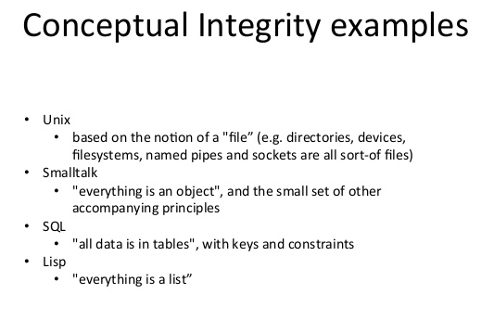

Slide 119
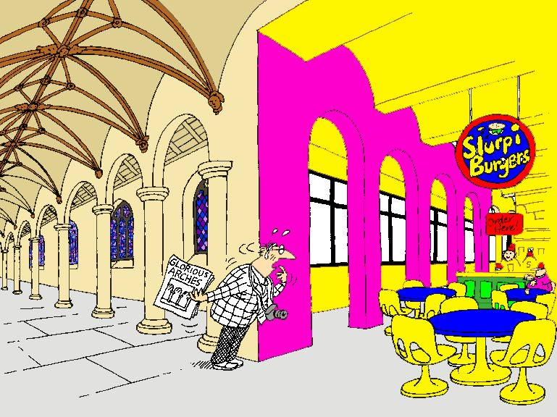
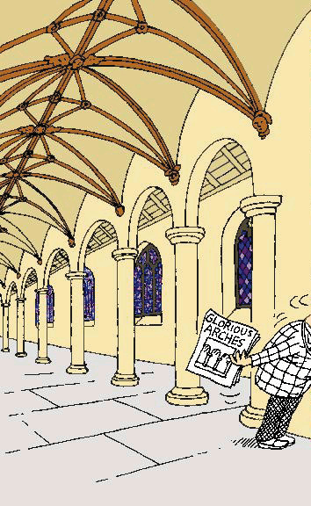
Conceptual integrity counter example!

Slide 120
ISO/IEC/IEEE 42010:2011 Conceptual Framework

